Slide 1
Covid-19 Data Project 3
Team 2 - B Ojimah, Z Karim, I Nira, Y Sabir & S Boateng

Slide 2
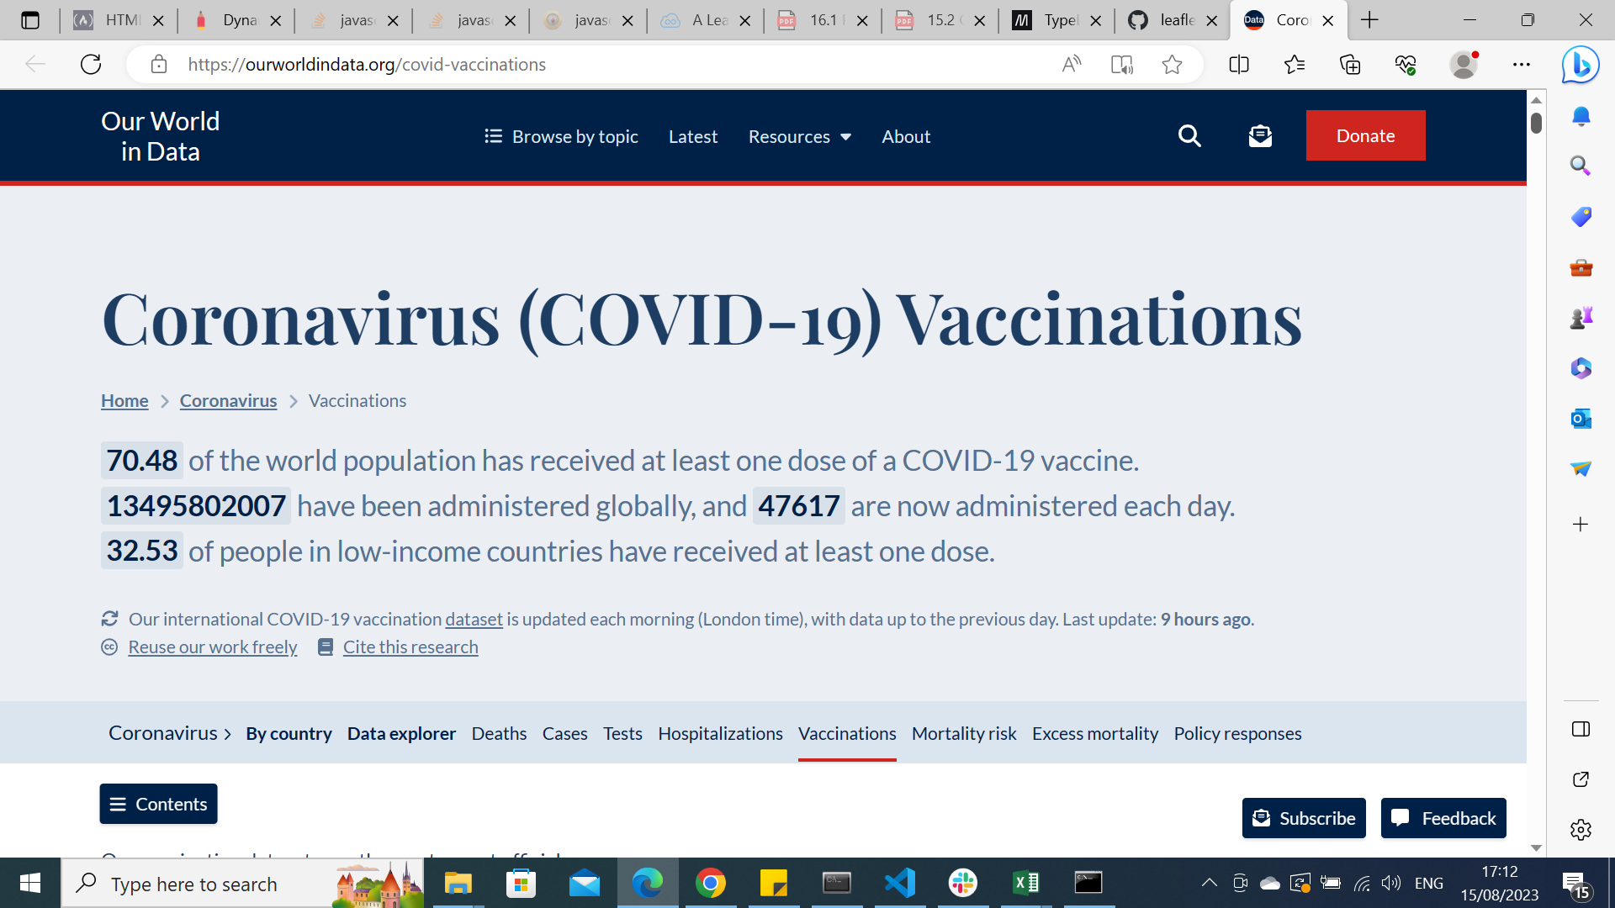
Data Source
Mathieu, E., Ritchie, H., Ortiz-Ospina, E. et al. A global database of COVID-19 vaccinations. Nat Hum Behav (2021)

Slide 3
Information within the dataset
> 300,000 records - daily COVID returns from around the world,
Multiple categories: ICU capacity, smoking status, disease, development index, absolute case rates, death rates etc.
Continuous data that is constantly being updated.

Slide 4
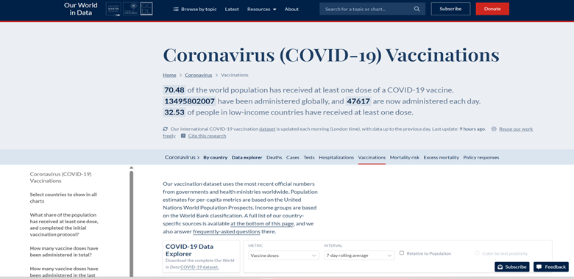
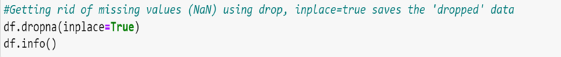


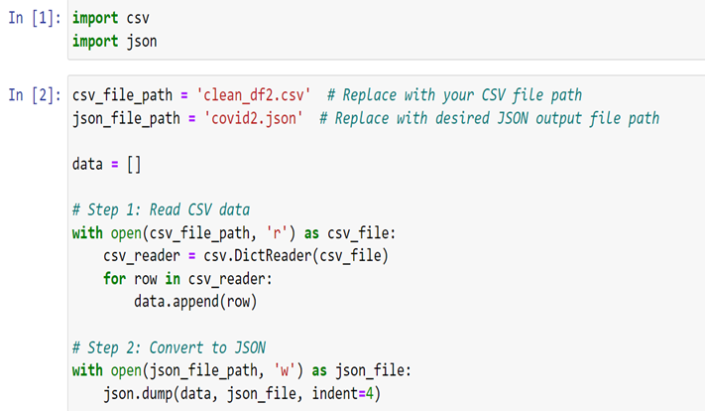
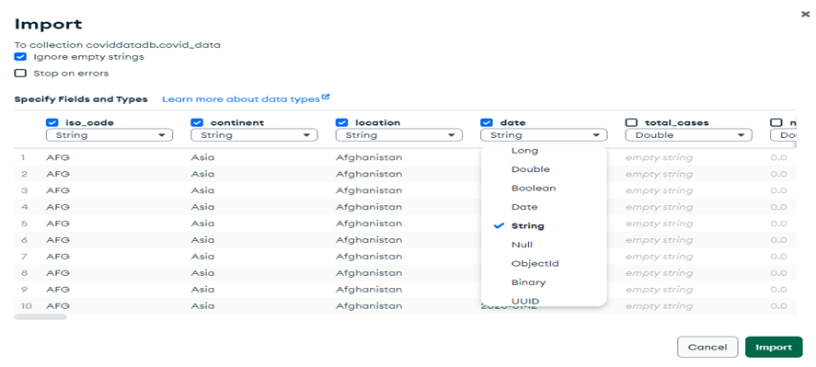
Data cleaning

Slide 5
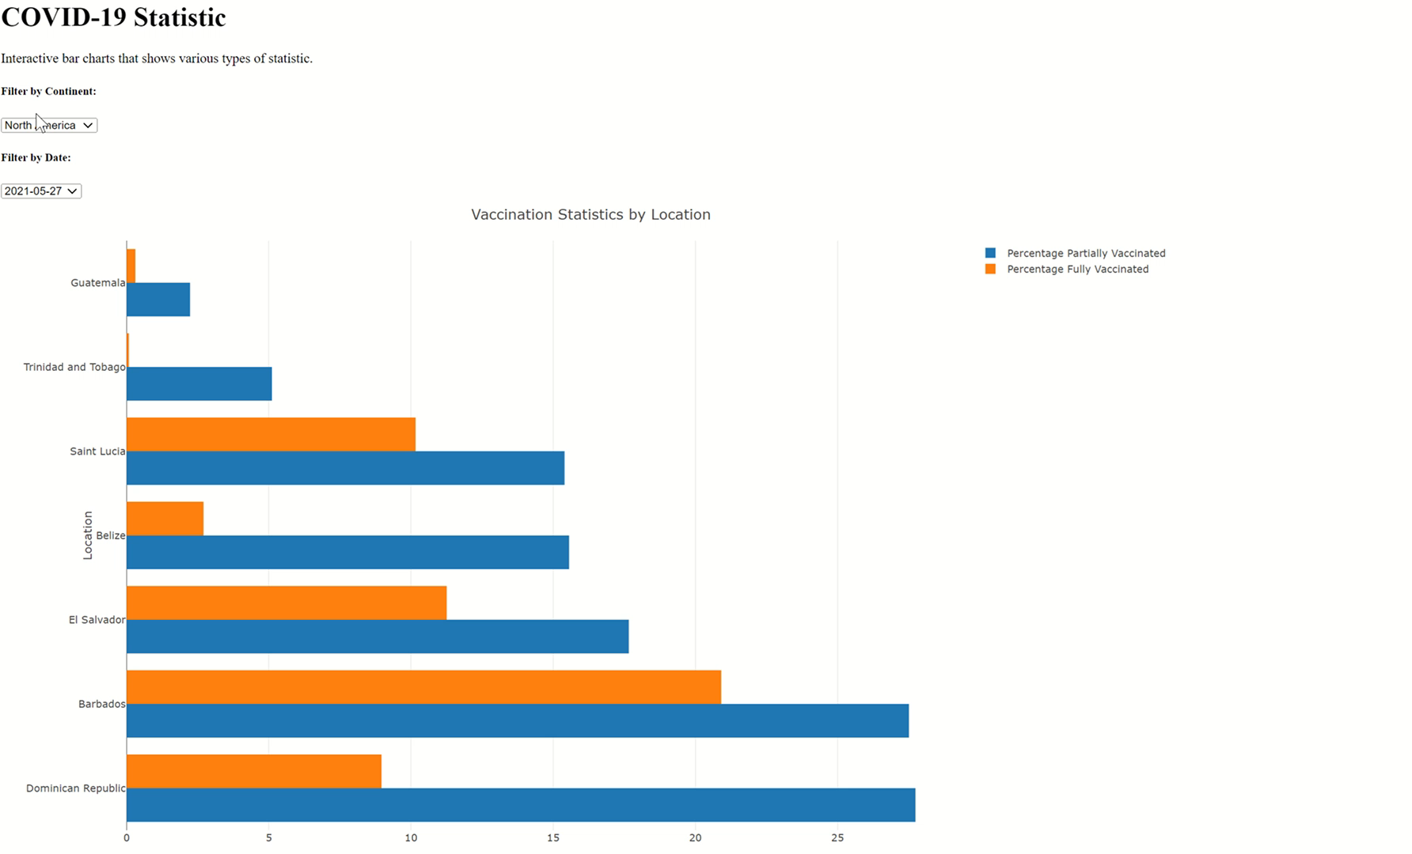
One & two doses of the vaccine

Slide 6
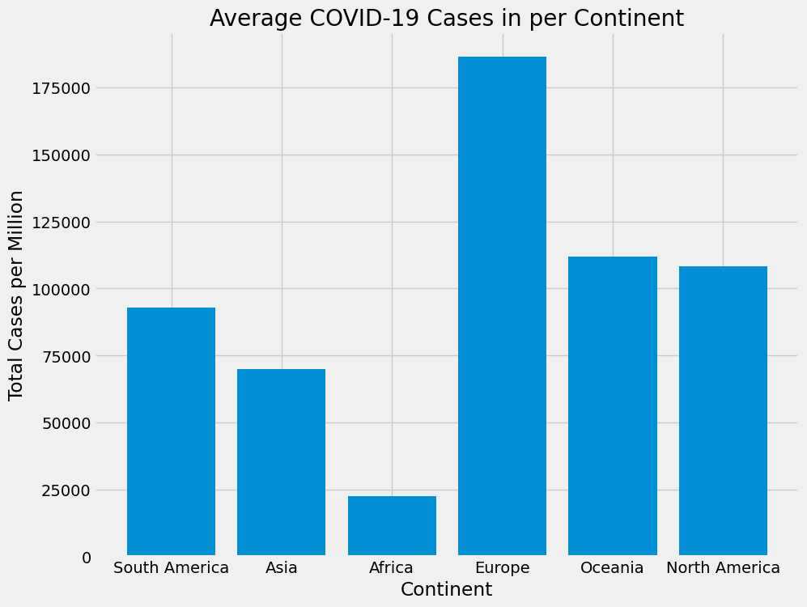
Average COVID_19 cases per continent showed Europe having on average the greatest number of cases.
Country with the Most Cases of COVID-19 on average: Cyprus
Country with the Least Cases of COVID-19 on average: Asia
Notes:
First of all the data we required was collected using web scraping. I then filtered the data and produced a bar chart displaying the cases per million in each continent. On average Europe had the greatest number of cases per million and Africa had the least number of cases.

Slide 7
Statistical test – Z score
 | Population Size | Total Number of Covid Cases to date | Z -score
Asia | 4,753,079,726 | 299562963 | -13.69
Africa | 1,460,481,772 | 13105369 | -142.35
Europe | 740,433,713 | 249063684 | 76.95
North America | 604,182,517 | 124412341 | 41.47
South America | 439,719,009 | 68804807 | 30.22
Australia/Oceania | 46,004,866 | 14414388 | 25.61
Notes:
I then conducted a statistical test on the population size and the total number of cases to calculate the z score. A negative value showed that the number of covid cases was less than the expected number and a positive score shows that the number of covid cases was more than expected.
Africa has a negative z score showing less cases than expected. We do not know if this is a true value as there could be multiple effecting factors. For example, the number of reported cases may not reflect the actual cases in that population.

Slide 8
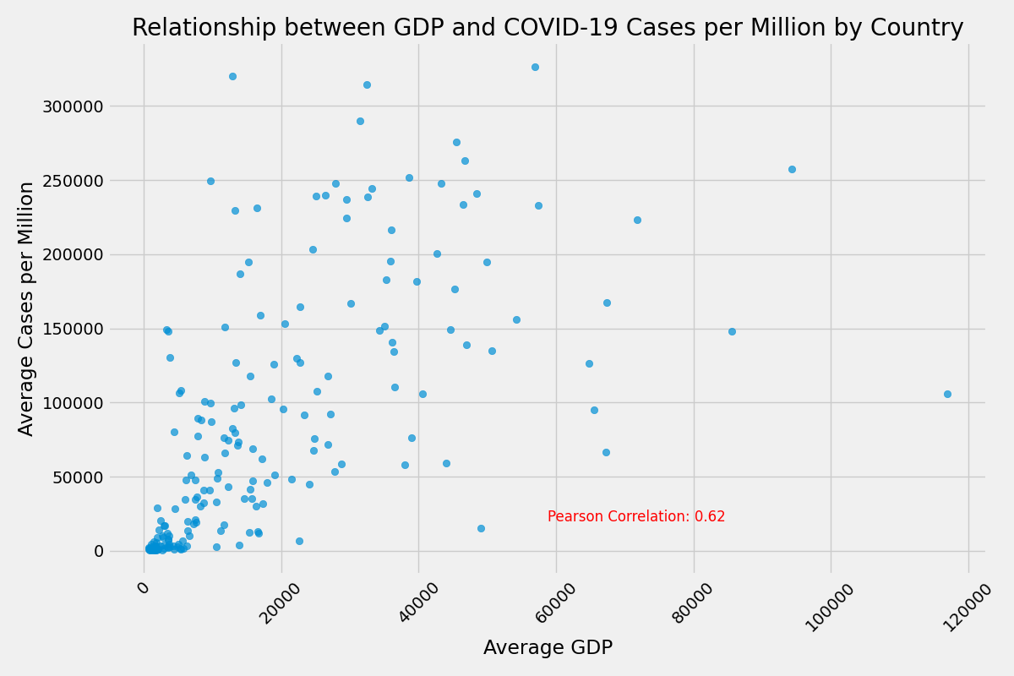
Positive Correlation between Average GDP per capita and COVID-19 cases per million in countries
1 indicates a strong positive linear correlation,
-1 indicates a strong negative linear correlation,
0 indicates no linear correlation.
The closer the absolute value of the coefficient is to 1, the stronger the correlation.
Notes:
I produced a scatter graph showing a positive correlation between average gpd and the average covid cases per million. And a Pearson corelation value of 0.62 which suggests a strong relation between the two variables. Observing that the scatter plot is denser between 0-20000 GDP per capita and contains data for the the least cases.
I wanted to explore that range in the graph and filter it by country which is shown in the next slide.
The scatter plot shows a relationship between the two variables, but it doesn't necessarily mean that higher GDP directly causes higher COVID-19 cases. There could be various other factors at play, such as population density, healthcare infrastructure, government policies, testing capabilities, and more, that influence the spread of COVID-19 in different countries.
To draw any meaningful conclusions or insights from this observation, further analysis and consideration of other relevant factors would be necessary.

Slide 9
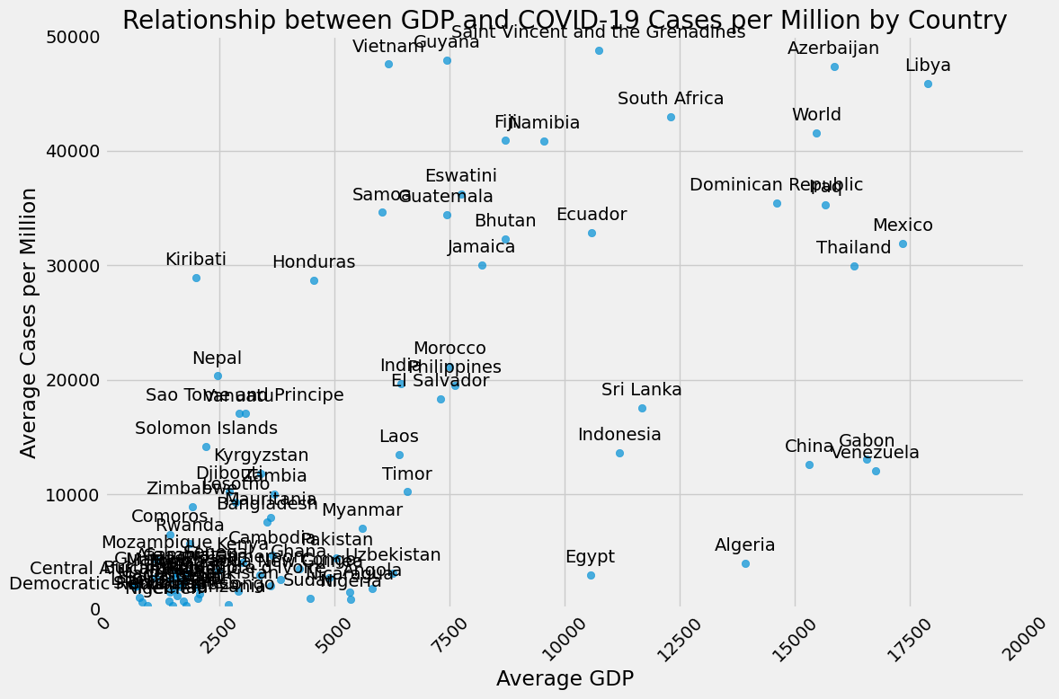
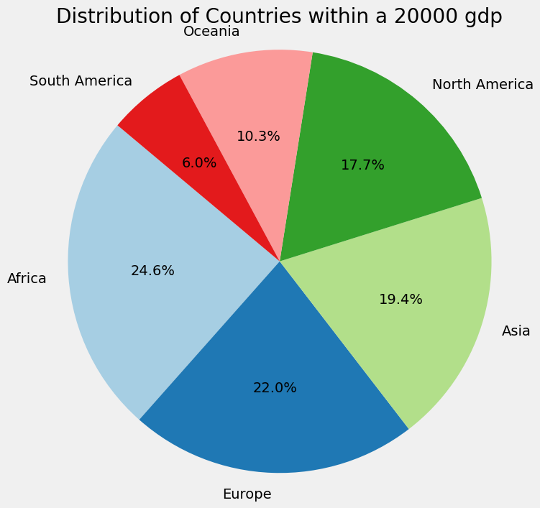
Distribution of COVID-19 cases per million <50000 within a 20000 GDP in countries.
Number of countries within the specified range: 88 countries
Notes:
The graph now displays the 88 countries within that range.
The pie chart displays the countries by continent within the specific area of the previous graph.
Europe and Africa are the biggest segments in the pie chart. Again Africa contains the majority of the countries with <50000 cases per million within the 20000gdp.

Slide 10
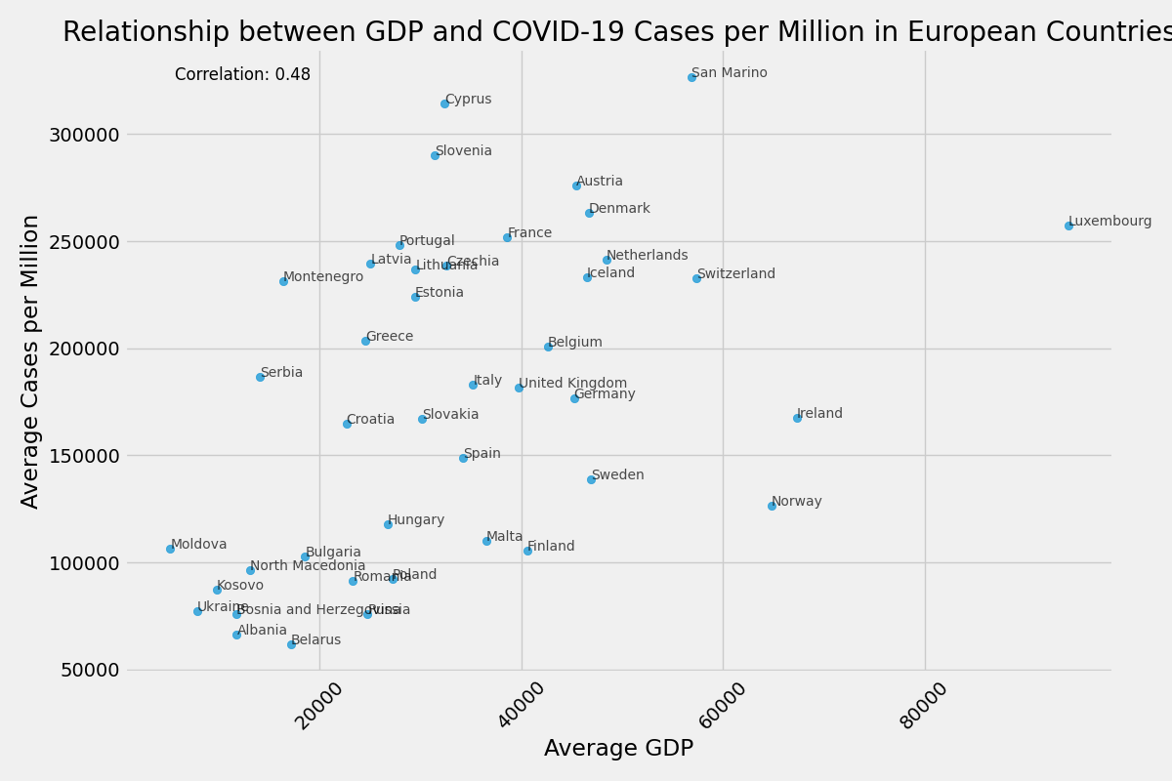
Average GDP per capita and COVID-19 cases per million in all European countries
Notes:
Out of interest I also displayed data for all the European countries which showed a positive correlation between gdp and covid cases per million.
the coefficient correlation value shows a moderate correlation suggesting there are other variables that could affect the number of cases.

Slide 11
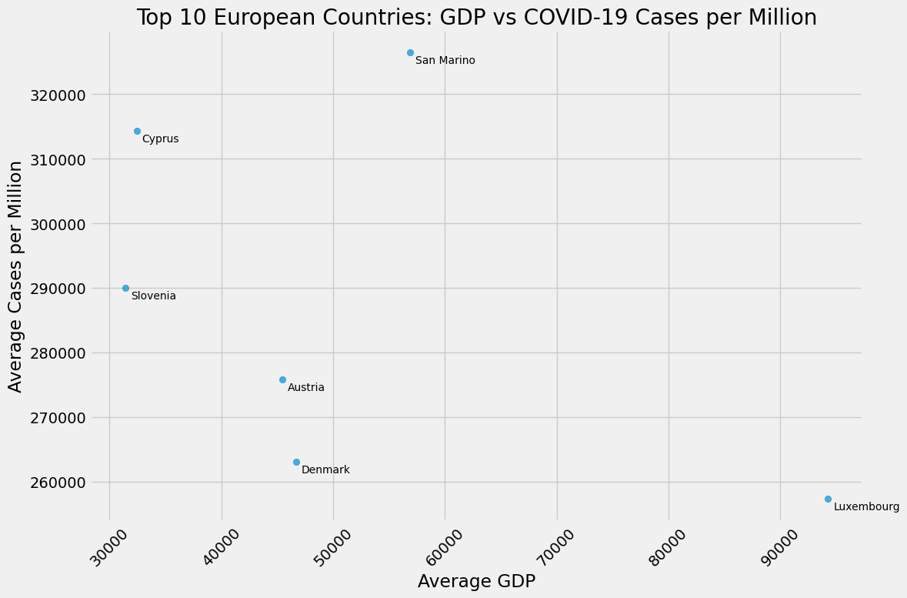
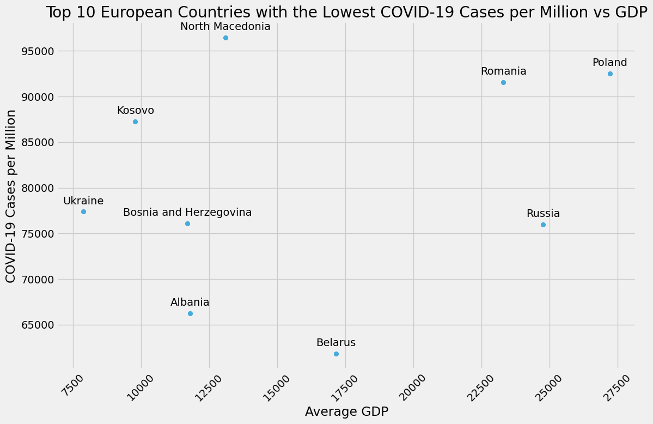
Average GDP per capita and COVID-19 cases per million in top ten highest and top 10 lowest European countries

Slide 12
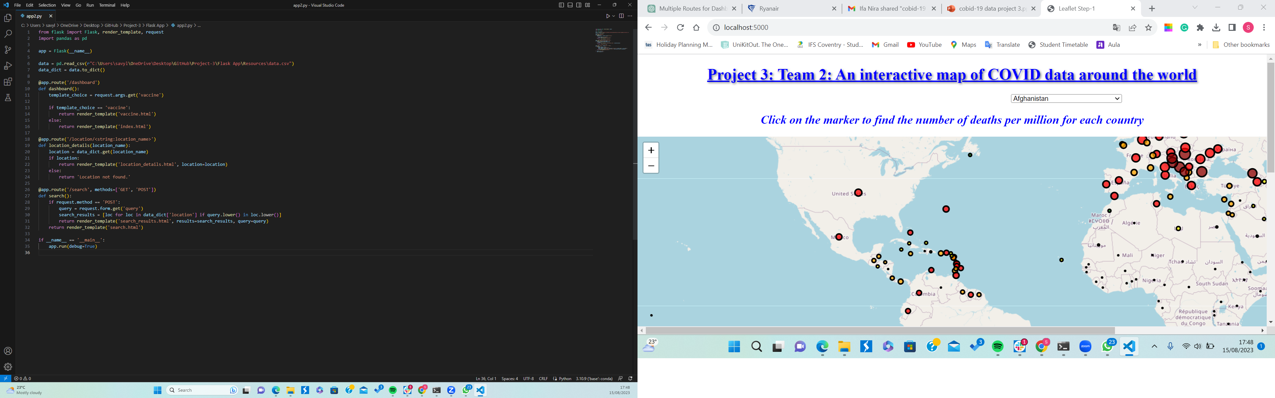
FLASK APP

Slide 13

Leaflet- What we learnt along the way

Slide 14
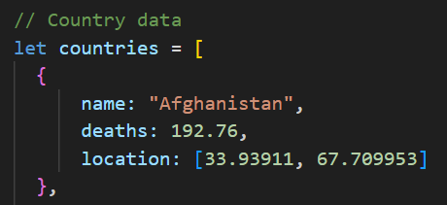
A map needs location data
Location dataset
Merge

Slide 15
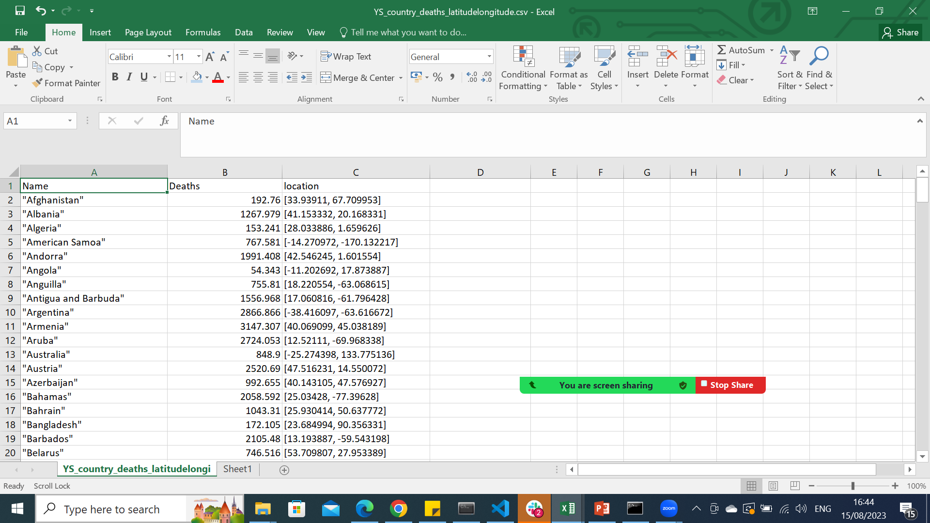
="""" & A1 & """"
And concatonate

Slide 16
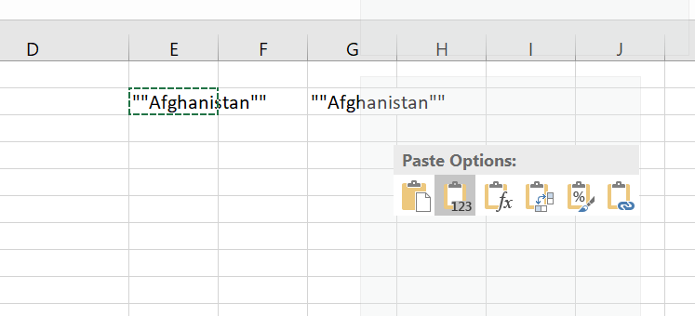
Paste as values to remove formulas

Slide 17
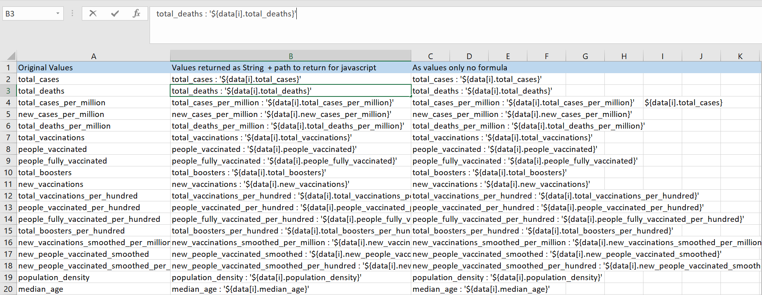
Harnessing Excel to transform values =A2 & " : '${data[i].value}'"

Slide 18
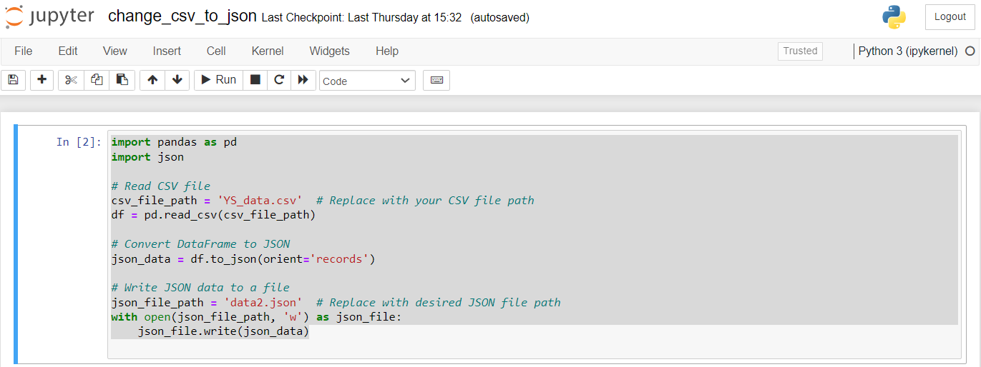
Our data was in csv format but we needed it be in json format

Slide 19

But the data returned as a string with extra quotations

Slide 20

Changing all occurances

Slide 21

Changing all occurances/ Find and replace

Slide 22

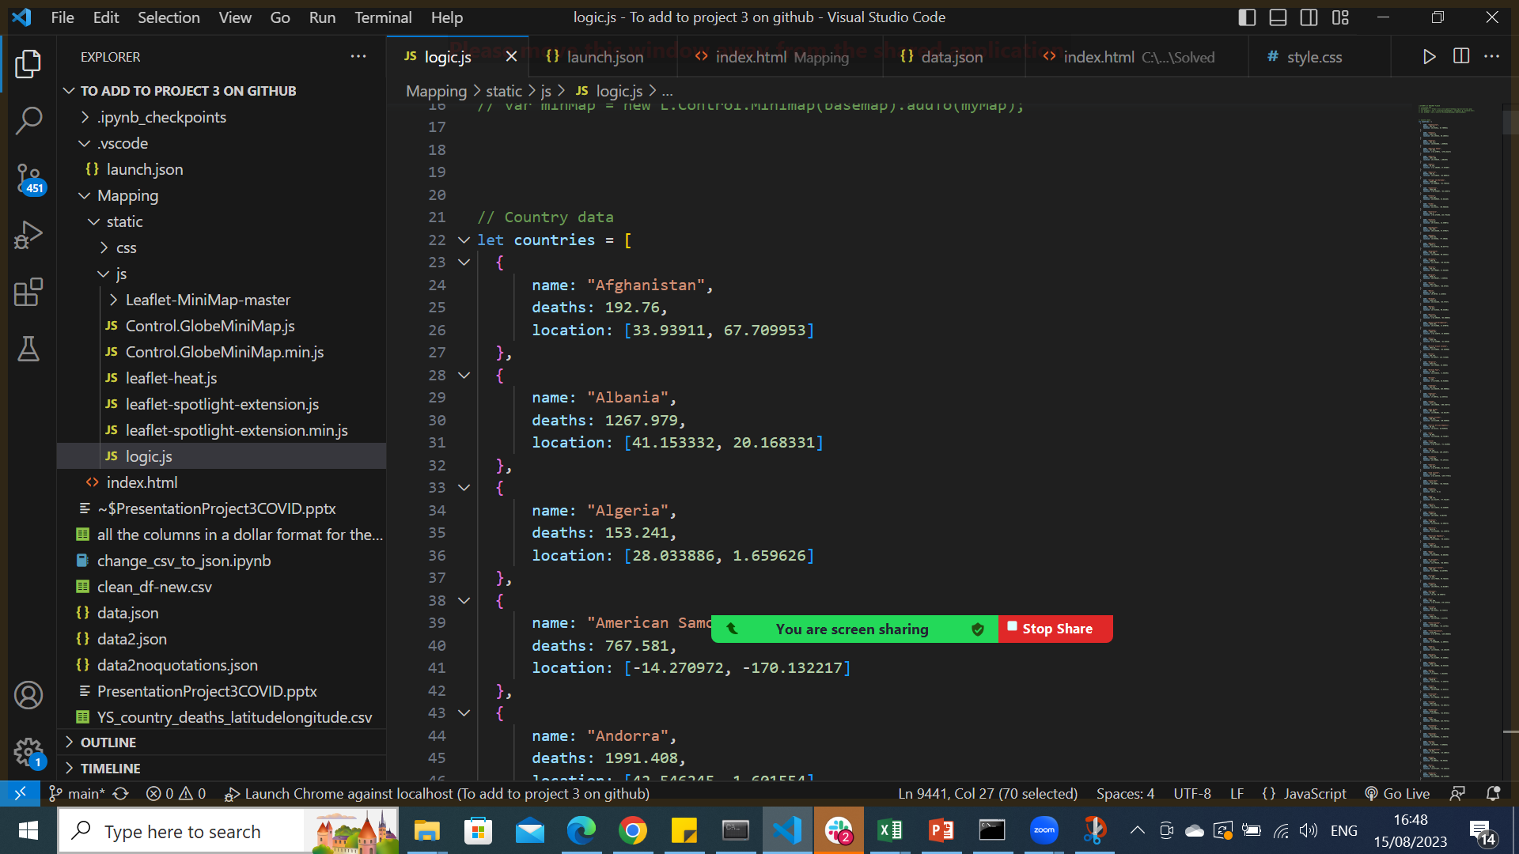
Hiding sections

Slide 23

Toggling on/off code – Ctrl + /

Slide 24
Errors
Multiple loops!

Slide 25

Knowing where your loop ends is critical

Slide 26

ChatGPT /Stackoverflow are our friends

Slide 27
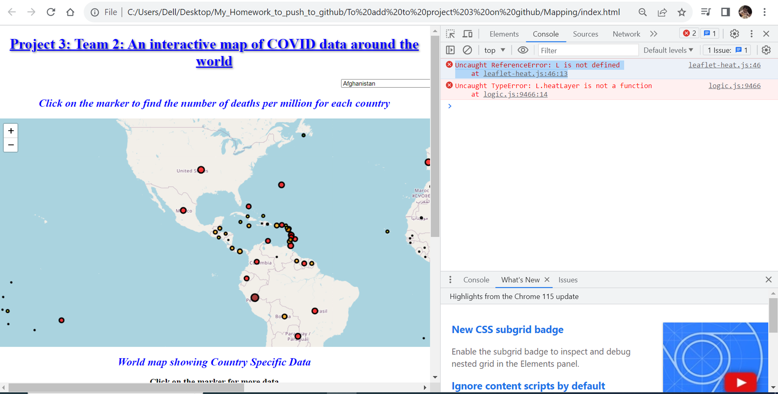

Slide 28

Plugins

Slide 29

Index.html <head> section

Slide 30
Conclusion
Vaccination Impact
Economic Influence
Successful Strategies
Vaccination Progress
Stringency Measures
Policy Effectiveness

Slide 31
THANK YOU FOR LISTENING!

